Slide 1
Data Mining – Cluster Analysis

Slide 2
Cluster analysis, also known as clustering, is a method of data mining that groups similar data points together. The goal of cluster analysis is to divide a dataset into groups (or clusters) such that the data points within each group are more similar to each other than to data points in other groups. This process is often used for exploratory data analysis and can help identify patterns or relationships within the data that may not be immediately obvious. There are many different algorithms used for cluster analysis, such as k-means, hierarchical clustering, and density-based clustering. The choice of algorithm will depend on the specific requirements of the analysis and the nature of the data being analyzed.
Cluster Analysis is the process to find similar groups of objects in order to form clusters. It is an unsupervised machine learning-based algorithm that acts on unlabelled data. A group of data points would comprise together to form a cluster in which all the objects would belong to the same group.

Slide 3
The given data is divided into different groups by combining similar objects into a group. This group is nothing but a cluster. A cluster is nothing but a collection of similar data which is grouped together.
For example, consider a dataset of vehicles given in which it contains information about different vehicles like cars, buses, bicycles, etc. As it is unsupervised learning there are no class labels like Cars, Bikes, etc for all the vehicles, all the data is combined and is not in a structured manner

Slide 4
Properties of Clustering :
1. Clustering Scalability: Nowadays there is a vast amount of data and should be dealing with huge databases. In order to handle extensive databases, the clustering algorithm should be scalable. Data should be scalable, if it is not scalable, then we can’t get the appropriate result which would lead to wrong results.
2. High Dimensionality: The algorithm should be able to handle high dimensional space along with the data of small size.
3. Algorithm Usability with multiple data kinds: Different kinds of data can be used with algorithms of clustering. It should be capable of dealing with different types of data like discrete, categorical and interval-based data, binary data etc.
4. Dealing with unstructured data: There would be some databases that contain missing values, and noisy or erroneous data. If the algorithms are sensitive to such data then it may lead to poor quality clusters. So it should be able to handle unstructured data and give some structure to the data by organising it into groups of similar data objects. This makes the job of the data expert easier in order to process the data and discover new patterns.

Slide 5
5. Interpretability: The clustering outcomes should be interpretable, comprehensible, and usable. The interpretability reflects how easily the data is understood.

Slide 6
Types Of Data Used In Cluster Analysis Are:
Interval-Scaled variables
Binary variables
Nominal, Ordinal, and Ratio variables
Variables of mixed types
Interval-Scaled Variables
Interval-scaled variables are continuous measurements of a roughly linear scale.
Typical examples include weight and height, latitude and longitude coordinates (e.g., when clustering houses), and weather temperature.
The measurement unit used can affect the clustering analysis. For example, changing measurement units from meters to inches for height, or from kilograms to pounds for weight, may lead to a very different clustering structure.
In general, expressing a variable in smaller units will lead to a larger range for that variable, and thus a larger effect on the resulting clustering structure.
To help avoid dependence on the choice of measurement units, the data should be standardized. Standardizing measurements attempts to give all variables an equal weight.
This is especially useful when given no prior knowledge of the data. However, in some applications, users may intentionally want to give more weight to a certain set of variables than to others.
For example, when clustering basketball player candidates, we may prefer to give more weight to the variable height.

Slide 7
1. Binary Variables
A binary variable is a variable that can take only 2 values.
For example, generally, gender variables can take 2 variables male and female.
2. Nominal or Categorical Variables
A generalization of the binary variable in that it can take more than 2 states, e.g., red, yellow, blue, green.
3. Ordinal Variables
An ordinal variable can be discrete or continuous.
In this order is important, e.g., rank.
It can be treated like interval-scaled

Slide 8
4. Variables Of Mixed Type
A database may contain all the six types of variables
symmetric binary, asymmetric binary, nominal, ordinal, interval, and ratio.
And those combinedly called as mixed-type variables.

Slide 9
Clustering Methods:
The clustering methods can be classified into the following categories:
Partitioning Method
Hierarchical Method
Density-based Method
Grid-Based Method
Model-Based Method
Constraint-based Method
Partitioning Method: It is used to make partitions on the data in order to form clusters. If “n” partitions are done on “p” objects of the database then each partition is represented by a cluster and n < p. The two conditions which need to be satisfied with this Partitioning Clustering Method are:
One objective should only belong to only one group.
There should be no group without even a single purpose.
In the partitioning method, there is one technique called iterative relocation, which means the object will be moved from one group to another to improve the partitioning

Slide 10
Hierarchical Method: In this method, a hierarchical decomposition of the given set of data objects is created. We can classify hierarchical methods and will be able to know the purpose of classification on the basis of how the hierarchical decomposition is formed. There are two types of approaches for the creation of hierarchical decomposition, they are:
Agglomerative Approach: The agglomerative approach is also known as the bottom-up approach. Initially, the given data is divided into which objects form separate groups. Thereafter it keeps on merging the objects or the groups that are close to one another which means that they exhibit similar properties. This merging process continues until the termination condition holds.

Slide 11
CURE(Clustering Using Representatives)
It is a hierarchical based clustering technique, that adopts a middle ground between the centroid based and the all-point extremes. Hierarchical clustering is a type of clustering, that starts with a single point cluster, and moves to merge with another cluster, until the desired number of clusters are formed.
It is used for identifying the spherical and non-spherical clusters.
It is useful for discovering groups and identifying interesting distributions in the underlying data.
Instead of using one point centroid, as in most of data mining algorithms, CURE uses a set of well-defined representative points, for efficiently handling the clusters and eliminating the outliers.

Slide 12
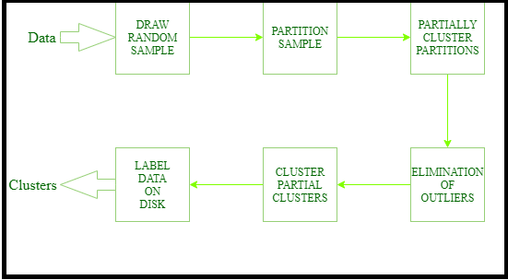
Six steps in CURE algorithm:

Slide 13
Divisive Approach: The divisive approach is also known as the top-down approach. In this approach, we would start with the data objects that are in the same cluster. The group of individual clusters is divided into small clusters by continuous iteration. The iteration continues until the condition of termination is met or until each cluster contains one object. Once the group is split or merged then it can never be undone as it is a rigid method and is not so flexible. The two approaches which can be used to improve the Hierarchical Clustering Quality in Data Mining are: –
One should carefully analyze the linkages of the object at every partitioning of hierarchical clustering.
One can use a hierarchical agglomerative algorithm for the integration of hierarchical agglomeration. In this approach, first, the objects are grouped into micro-clusters. After grouping data objects into microclusters, macro clustering is performed on the microcluster.

Slide 14
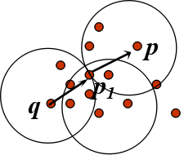
Density-Based Method: The density-based method mainly focuses on density. In this method, the given cluster will keep on growing continuously as long as the density in the neighbourhood exceeds some threshold, i.e, for each data point within a given cluster. The radius of a given cluster has to contain at least a minimum number of points.
Density-Based Clustering - Background
Two parameters:
Eps: Maximum radius of the neighborhood.
MinPts: Minimum number of points in an Eps-neighbourhood of that point.
Density-reachable:
A point p is density-reachable from a point q wrt. Eps, MinPts if there is a chain of points p1, …, pn, p1 = q, pn = p such that pi+1 is directly density-reachable from pi

Slide 15
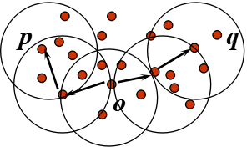
Density-connected
A point p is density-connected to a point q wrt. Eps, MinPts if there is a point o such that both, p and q are density-reachable from o wrt. Eps and MinPts.

Slide 16
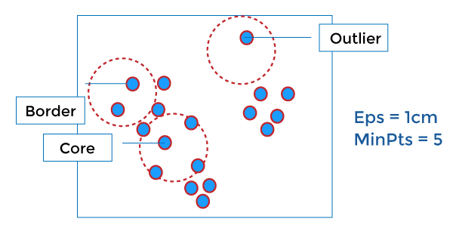
Density-Based Clustering - DBSCAN, OPTICS & DENCLUE
DBSCAN
DBSCAN stands for Density-Based Spatial Clustering of Applications with Noise. It depends on a density-based notion of cluster. It also identifies clusters of arbitrary size in the spatial database with outliers.

Slide 17
OPTICS
OPTICS stands for Ordering Points To Identify the Clustering Structure. It gives a significant order of database with respect to its density-based clustering structure. The order of the cluster comprises information equivalent to the density-based clustering related to a long range of parameter settings. OPTICS methods are beneficial for both automatic and interactive cluster analysis, including determining an intrinsic clustering structure.
DENCLUE
It enables a compact mathematical description of arbitrarily shaped clusters in high dimension state of data, and it is good for data sets with a huge amount of noise.

Slide 18
Grid-Based Method: In the Grid-Based method a grid is formed using the object together,i.e, the object space is quantized into a finite number of cells that form a grid structure. One of the major advantages of the grid-based method is fast processing time and it is dependent only on the number of cells in each dimension in the quantized space. The processing time for this method is much faster so it can save time.
Model-Based Method: In the model-based method, all the clusters are hypothesized in order to find the data which is best suited for the model. The clustering of the density function is used to locate the clusters for a given model. It reflects the spatial distribution of data points and also provides a way to automatically determine the number of clusters based on standard statistics, taking outlier or noise into account. Therefore it yields robust clustering methods.
Constraint-Based Method: The constraint-based clustering method is performed by the incorporation of application or user-oriented constraints. A constraint refers to the user expectation or the properties of the desired clustering results. Constraints provide us with an interactive way of communication with the clustering process. The user or the application requirement can specify constraints.

Slide 19
Applications Of Cluster Analysis:
It is widely used in image processing, data analysis, and pattern recognition.
It helps marketers to find the distinct groups in their customer base and they can characterize their customer groups by using purchasing patterns.
It can be used in the field of biology, by deriving animal and plant taxonomies and identifying genes with the same capabilities.
It also helps in information discovery by classifying documents on the web.

Slide 20
Advantages of Cluster Analysis:
It can help identify patterns and relationships within a dataset that may not be immediately obvious.
It can be used for exploratory data analysis and can help with feature selection.
It can be used to reduce the dimensionality of the data.
It can be used for anomaly detection and outlier identification.
It can be used for market segmentation and customer profiling.
Disadvantages of Cluster Analysis:
It can be sensitive to the choice of initial conditions and the number of clusters.
It can be sensitive to the presence of noise or outliers in the data.
It can be difficult to interpret the results of the analysis if the clusters are not well-defined.
It can be computationally expensive for large datasets.
The results of the analysis can be affected by the choice of clustering algorithm used.

Slide 21
Types of Outliers in Data Mining

Slide 22
Outlier is a data object that deviates significantly from the rest of the data objects and behaves in a different manner. An outlier is an object that deviates significantly from the rest of the objects. They can be caused by measurement or execution errors. The analysis of outlier data is referred to as outlier analysis or outlier mining.
An outlier cannot be termed as a noise or error. Instead, they are suspected of not being generated by the same method as the rest of the data objects.
Outliers are of three types, namely –
Global (or Point) Outliers
Collective Outliers
Contextual (or Conditional) Outliers

Slide 23
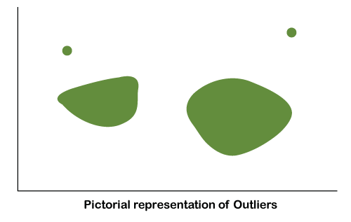
Outliers are an integral part of data analysis. An outlier can be defined as observation point that lies in a distance from other observations.
An outlier is important as it specifies an error in the experiment. Outliers are extensively used in various areas such as detecting frauds, introducing potential new trends in the market and others.
Usually, outliers are confused with noise. However, outliers are different from noise data in the following sense:
Noise is a random error, but outlier is an observation point that is situated away from different observations.
Noise should be removed for better outlier detection.

Slide 24
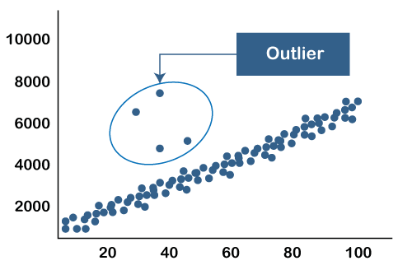
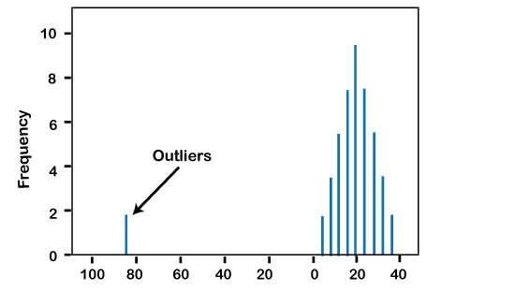
Given below are two graphical examples of outliers:
As shown in this graph, the outliers are points that lie outside the entire pattern of distribution.
Another illustration of outliers can be seen in the histogram given below. In this, one point lies far away from the remaining, this point is an outlier.

Slide 25
Various causes of outliers in Data Mining
There are various causes of outliers in Data Mining. Some of these causes are given below:
It is used in identifying the frauds in banking sectors such as credit card hacking or any similar frauds.
It is used in observing the change in trends of buying patterns of a customer.
It is used in identifying the typing errors and reporting errors made by humans.
It is used in discovering the errors or faults in machines or systems
What is the need of handling the outliers in Data Mining?
There are various reasons to handle the outliers in Data Mining. Some of those reasons are listed below:
Outliers affect the results of the databases.
Outliers often give useful or beneficial results and conclusions due to which various trends or patterns can be recorded.
Outliers can be beneficial in research department also. They can be extremely useful in some discovery.
Outliers are the key branches of data mining.

Slide 26
Applications of Outlier Detection in Data Mining
In Data Mining, Outlier Detection is extensively used. It is used to obtain patterns or trends in data mining. The applications of Outlier Detection in Data Mining are given below:
Fraud Detection
Telecom Fraud Detection
Intrusion Detection in Cyber Security
Medical Analysis
Environment Monitoring such as Cyclone, Tsunami, Floods, Drought and so on
Noticing unforeseen entries in Databases

Slide 27
What is Outlier Analysis?
Outlier Analysis can be defined as the process in which abnormal or non-typical observations in a data set is identified.
Outlier Analysis can also be called “Outlier Mining”.
The outliers in Outlier Detection have a particular concern. These concerns are usually shown in fraud detection and intrusion detection. In fraud detection, the outliers show the fraudulent activity. Therefore, outlier detection and analysis are very beneficial part of data mining tasks. This process is known as “Outlier Mining” or “Outlier Analysis”.

Slide 28
Different approaches in Outlier Detection
There are majorly three approaches observed in outlier detection. Those approaches are given below:
The Statistical Approach
The Distance Based Approach
The Deviation Based Approach
Outlier Detection techniques
There are four major outlier detection techniques:
Numeric
Z-Score
DBSCAN
Isolation forest

Slide 29
1. Numeric:
This is the simplest method in a single dimensional feature space. In this method, the outliers are calculated with the help of IQR (InterQuartile Range) approach. It is also nonparametric.
2. Z-Score:
Z-score is a parametric outlier detection method in a single or low dimensional feature space. In Z-score technique, it is assumed that there is a Gaussian distribution of the data. Zi is calculated using the formula given below:
Z score = (x -mean) / std. deviation
3. DBSCAN:
This Outlier Detection technique is based on the DBSCAN clustering method. DBSCAN is a nonparametric, density-based outlier detection method in one or more than one dimensional feature space. In this, all the data points are described as Core Points, Border Points or Noise Points.

Slide 30
4.
Isolation Forest:
Isolation Forest is a nonparametric approach that is mainly designed for huge sets of data in a one or more than one dimensional feature space. In this approach, an essential concept is isolation numbers which can be defined as the number of splits required to isolate a data point.

